Slide 1
Pavia River
António Castanheira, nº3
Francisco Albuquerque, nº10
Mariana Seixas, nº23

Slide 2
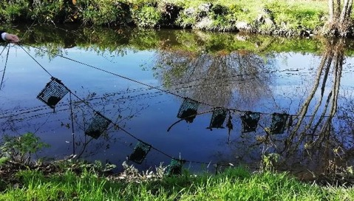
LivingRiver

Slide 3
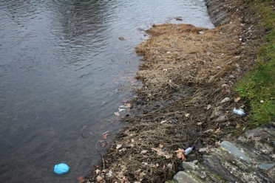
Rivers
image of the degraded Pavia river, currently (taken by us);
From: https://jra.abae.pt/plataforma/artigo/rios-poluidos-ate-quando/

Slide 4
Rivers
graph representing the increase in water use, coinciding with the increase in population

Slide 5
Importance of rivers
Sustainability
Biodiversity near by Pavia river (taken by us )

Slide 6
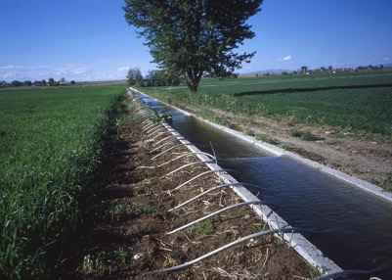
Importance of rivers
Irrigations
irrigation channel with siphon system (https://pt.wikipedia.org/wiki/Irrigação#/media/Ficheiro:SiphonTubes.JPG)

Slide 7
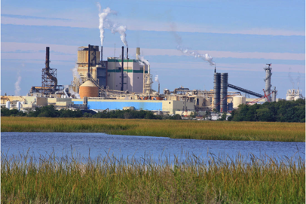
Importance of rivers
Comsumption
Industrial water use (https://www.usgs.gov/media/images/industrial-water-use-brunswick-cellulose-paper-plant-brunswick-ga)

Slide 8
Importance of rivers
Culture and identity
cultural events at Casa da Ribeira (taken by us)

Slide 9
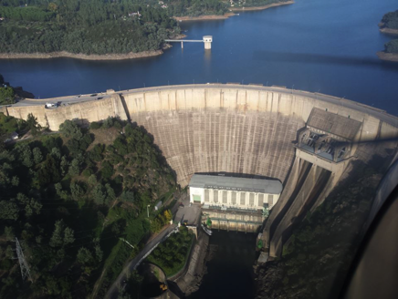
Importance of rivers
Energy
dam of Castelo de Bode – hydroelectric energy (http://tomarnarede.blogspot.com/2017/01/barragem-de-castelo-do-bode-inaugurada.html)

Slide 10
Importance of rivers
History
Pavia river formerly – Casa da Ribeira (taken by us)

Slide 11
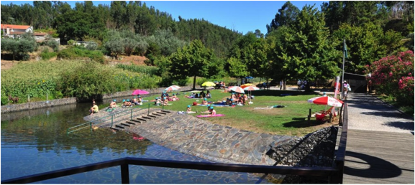
Importance of rivers
Leisure
River beaches (https://escapadinhas.org/escapadinhas-centro/praias-fluviais/)

Slide 12
Importance of rivers
Rural and urban landscape
Landscape of Pavia river in Viseu (taken by us)

Slide 13
Importance of rivers
Fishing
fishing in ancient times – Casa da Ribeira (taken by us)

Slide 14
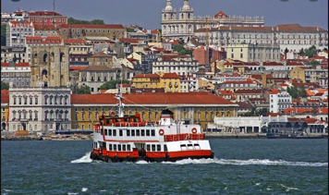
Importance of rivers
Transportation
old boat used on the river Pavia – Casa da Ribeira (taken by us)
Boat on Tejo river (https://www.pinterest.pt/pin/221802350374806596/)

Slide 15
How do we preserve the rivers?
Reduce water usage
(https://pagdand.org/water-bodies-conservation/)

Slide 16
How do we preserve the rivers?
Ecological products
Use products with recyclable biodegradable packages (https://www.goodstartpackaging.com)
Limiting the use of pesticides (https://www.mainerdo.com/en/sustainable-agriculture/)
(https://www.environmentblog.net/eco-friendly-products/)

Slide 17
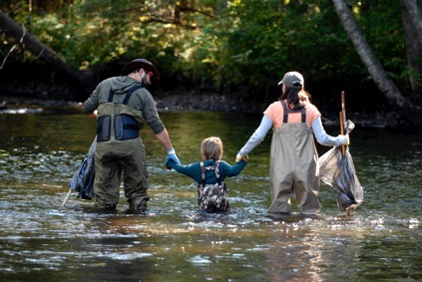
How do we preserve the rivers?
Reporting polluction
River cleaning groups (https://gateslodge.com/event/au-sable-river-cleanup-2/)

Slide 18
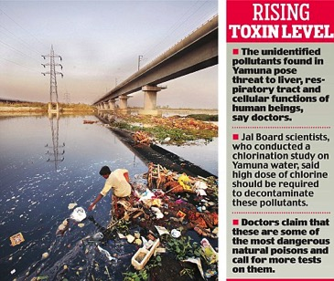
How do we preserve the rivers?
Encouraging people to save rivers
News about environment (https://www.dailymail.co.uk/indiahome/indianews/article-2442743/Doctors-tests-mystery-pollution-Yamuna.html)

Slide 19
Pavia river
Pavia river in Viseu (taken by us)

Slide 20
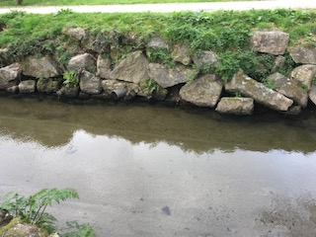
Pavia river
Low avarege flow (taken by us)
Pavia river pollucted (taken by us)

Slide 21
Pavia river
river pavia formerly – Casa da Ribeira (taken by us)

Slide 22
Pavia river
Sewage discharge pipes (taken by us)

Slide 23
Pavia river
Sewage collector in S. Salvador (taken by us)

Slide 24
Pavia river
Pavia river in Parque de Santiago and in Ribeira (taken by us)

Slide 25
Pavia river
Garbage and weed vegetation along the Pavia river (taken by us)

Slide 26
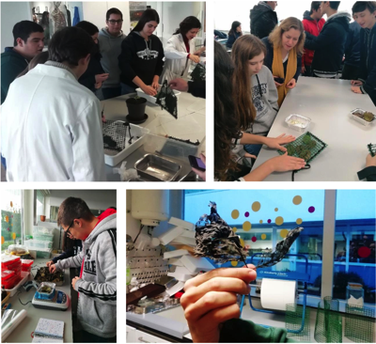
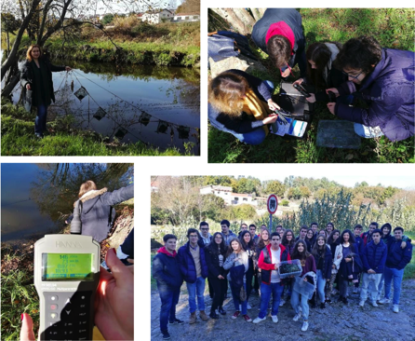
Experimental activity
(https://esam.pt/images/Projetos/livingriver/ativ.3-decomposicao-1.pdf)

